Slide 1
ISYS 2109 Demonstration: Excel 2 – Spreadsheet Planning/Design and Using Excel Functions
(Last update: Mar 2011)

Slide 2
SPREADSHEET PLANNING/DESIGN

Slide 3
Steps in Creating a Spreadsheet
Plan
Identify goals
List requirements for input, calculations and output (possibly using an IPO Chart)
Sketch worksheet layout
Build
Labels, values, formulae
Format for professional appearance

Slide 4
Planning the Spreadsheet
Planning usually involves 2 steps
- Understanding and analysing the problem and the desired solution
- Preparing a paper-based plan for your workbook

Slide 5
Understanding the Problem and the Solution
What am I trying to achieve?
What solution am I seeking?
What data do I need to achieve this solution?
List all of the data which will be required
What is the best design for entering the data?
Generally data is entered in Tables

Slide 6
Aims of the Worksheet
Example: Hammer Wines
Quickly analyse sales
Determine the commission earned by the sales representatives
Analyse the product data to determine appropriate changes to the product mix
Determine which areas require more focus by the sales representatives

Slide 7
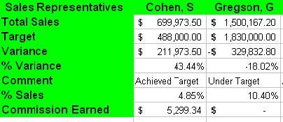
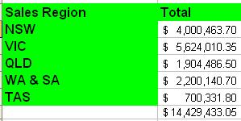
Solutions
Compare actual sales to set targets for each sales rep
Sales variance = Actual sales – Set target
Calculate % sales variance for each sales rep to determine the commission rate
% sales variance = Sales variance / Set target
Determine value of sales commission to each sales representative
Commission = Commission rate (%) X Sales variance
Sales $ by region
Sum of all actual sales of all sales representatives in each region

Slide 8
Design
Good models are
simple
flexible
complete
changes to data are reflected everywhere necessary
changes do not affect other parts adversely

Slide 9
Design (continued)
To achieve this, first think about your model in terms of an IPO Chart:
Output: Output information to be generated
Input: Input data required
Processing: Calculations performed on the Inputs to produce the Outputs

Slide 10
Example 1: Input/Processing/Output Table
Adding two numbers
INPUT | PROCESSING | OUTPUT
A: First input number B: Second input number | C = A + B (Add two numbers together) | C

Slide 11
Example 2: Input/Processing/Output Table
Creating a Mailing List of clients sorted by State and Postcode
Input | Processing | Output
Client id Company name Address Suburb State Postcode | For all the Clients: Step 1: Sort by state Step 2: Sort by postcode | List of clients and their details sorted by state, and sorted by postcode Mailing List (Formatted)

Slide 12
Example 3: Input/Processing/Output Table
Calculating the Profit (part of the Hammer Wines example from the Excel 1 Workshop)
Input | Processing | Output
Profit margin Total sales for each product | Step 1: Look up the profit margin for each product using the profit margin table Step 2: Profit= Profit margin* Total sales for each product | Profit

Slide 13
Other Examples
Other examples of IPO charts are provided on the MyRMIT Studies site for this course

Slide 14
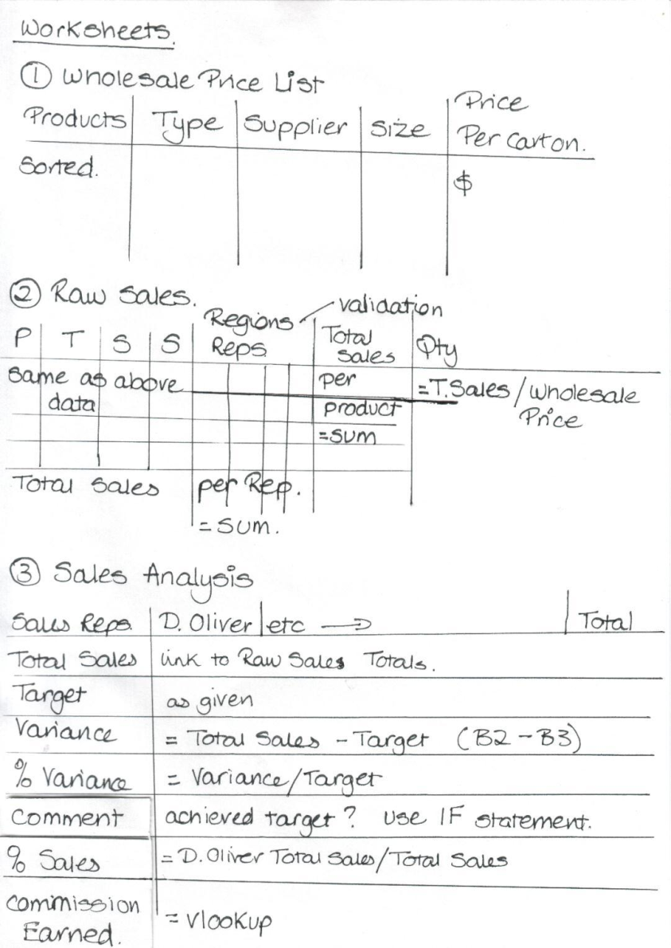
Design (continued)
You can also sketch the planned layout of the worksheets (see the example in your Excel Workshop 1 notes)

Slide 15
BUILDING EFFECTIVE WORKSHEETS

Slide 16
Building Effective Worksheets
An effective worksheet is
well planned
carefully built
thoroughly tested
comprehensively documented

Slide 17
Build: Means of Data Input
Tables will be used to store base data such as Profit margins on various products
Functions such as VLOOKUP will be used to identify the correct entries to use.
(See Hammer Wines example in the Excel 2 Workshop)

Slide 18
Build: Implementing Processing and Output Worksheets
Separate worksheets will be implemented for Input, Processing and Output
Input and Output worksheets should NOT include any calculations

Slide 19
Build: Test and Document
Test
Make sure the correct results are produced
Document
Record information others need to understand, use and revise the worksheet
It may be necessary to go back to an earlier step at any time through the development

Slide 20
Build: Documenting
Use:
Range Names
Cell Notes
amplify design features, explanations, etc (can add sounds & speech)
Many of the worksheets you write will be passed on for others to operate, maintain or develop
Good work that will survive and be of benefit to an organisation will be well designed and documented

Slide 21
USING EXCEL FUNCTIONS

Slide 22
Excel Workshop 2
Additional Features/Functions covered in the Excel 2 Workshop include:
Sort data
Rename worksheets
Understand and use absolute and relative cell addressing
Create range names and use them in a formula
Use the following formula: sum, sumif, if, vlookup
Plus
How to create charts and change their format

Slide 23
Excel Workshop 2
Additional Functions:
SUM(cell range) Returns the sum of all the numbers in the specified range of cells.
SUMIF(range,criteria,sum_range)
Adds the cells specified by a given criteria
Range is the range of cells that you want evaluated by criteria.
Criteria is the criteria in the form of a number, expression, or text that defines which cells will be added.
Sum_range are the actual cells to add if their corresponding cells in range match criteria.

Slide 24
Excel Workshop 2
Additional Functions:
IF(logical_test, value_if_true, value_if_false) Returns one value if a condition you specify evaluates to TRUE and another value if it evaluates to FALSE.
VLOOKUP(lookup_value, table_array, col_index_num, range_lookup) Searches for a value in the first column of a table array and returns a value in the same row from another column in the table array.

Slide 25

Be good and
work hard
Thank you
Have fun trying all these (and more) out in your Excel 2 Workshop this week

